Slide 1



DEPARTMENT OF COMPUTER SCIENCE & ENGINEERING
SCHOOL OF COMPUTING
10214CS602 MINOR PROJECT -2
WINTER SEMESTER(2023-2024)
REVIEW-1
“AI AUDITOR: CRAFTING YOUR PERFECT PLAYLIST WITH MACHINE LEARNING”
SUPERVISED BY
PRESENTED BY
Mrs.S.Thylasri Assistant professor
1.MANDHALA MANOJ BABU (VTU19600)(21UECM0149)
2.CHAKALI VIJAYMANI (VTU19315)(21UECM0041)
3.RAPURU GAUTAM (VTU19434)(21UECM0198)

Slide 2
OVERVIEW
ABSTRACT
OBJECTIVES
TIMELINE OF THE PROJECT
INTRODUCTION
LITERATURE REVIEW
DESIGN AND METHODOLOGIES
IMPLEMENTATION
CONCLUSION
REFERENCES

Slide 3
ABSTRACT
The music industry has undergone major changes from its conventional existence and also in the form of music created in last few years. The ever-growing customer base has also increased the market for different music styles.
A music genre is a conventional category that identifies some pieces of music as belonging to a shared tradition or set of conventions.
Music can be divided into different genres in many Different ways. The popular music genres are Pop, Hip-Hop, Rock, Jazz, Blues, Country and Metal.
Categorizing music files According to their genre is a challenging task in the area of music information retrieval (MIR).
Automatic music genre Classification is important to obtain music from a large collection. It finds applications in the real world in various fields like Automatic tagging of unknown piece of music (useful for apps like Saavn, Wynk etc.).

Slide 4
OBJECTIVES
Aim of the Project:
Audio processing is one of the most complex tasks in data science as compared to image processing and other classification techniques. One such application is music genre classification which aims to classify the audio files in certain categories of sound to which they belong. The application is very important and requires automation to reduce the manual error and time because if we have to classify the music manually then one has to listen out each file for the complete duration.
Scope of the Project:
Scope of the project " AI AUDITOR: CRAFTING YOUR PERFECT PLAYLIST WITH MACHINE LEARNING " to give multiple audio files, and the task is to categorize each audio file in a certain category like audio belongs to Disco, hip-hop, etc.

Slide 5
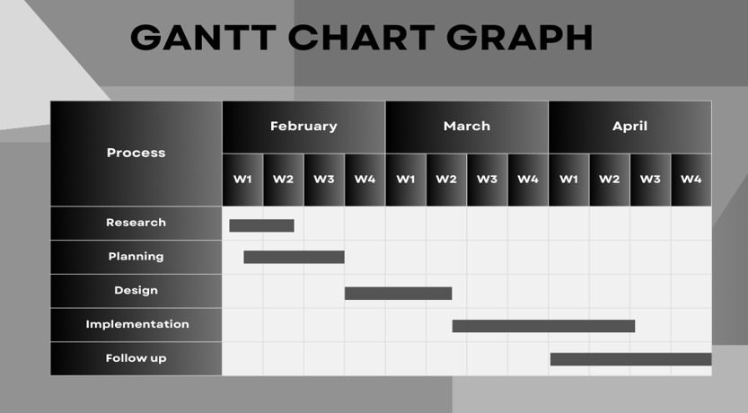
TIMELINE OF THE PROJECT

Slide 6
INTRODUCTION
Audio classification is an Application of machine learning where different sound is categorized in certain categories.
The music genre classification can be built using different approaches in which the top 4 approaches that are mostly used are listed below.
K-Nearest Neighbors
Multiclass support vector machine
K-means clustering algorithm
Convolutional neural network.
We will use K-Nearest Neighbors algorithm because various researches prove it is one of the best algorithms to give good performance and till time along with optimized models organizations uses this algorithm in recommendation systems as support.
K-Nearest Neighbour (KNN) is a machine learning algorithm used for regression, and classification. It is also known as the lazy learner algorithm. It simply uses a distance-based method o find the K number of similar neighbours to new data and the class in which the majority of neighbours lies, it results in that class as an output. Now let us get our system ready for project implementation.

Slide 7
LITERATURE REVIEW
Author’s Name | Paper name and publication details | Year of publication | Main content of the paper
Ossama Abdel-Hamid, Abdel-rahman Mohamed, Hui Jiang, Li Deng, Gerald Penn, and Dong Yu | IEEE/ACM Transactions on audio, speech, and language processing 22(10):1533–1545. | 2020 | Convolutional neural networks for speech recognition
Lam Hoang | ACM Symposium on Neural Gaze Detection, Woodstock, NY . ACM, New York, NY, USA, 3 pages. https://doi.org/10.1145/ 1122445.112245. | 2018 | Literature Review about Music Genre Classification. In Woodstock ’18

Slide 8
Authors name | Paper name and publication details | Year of publication | Main content of the paper
Hareesh Bahuleyan | CoRR, abs/1804.01149 | 2018 | Music genre classification using machine learning techniques
Prajwal R*1, Shubham Sharma*2, Prasanna Naik*3, Mrs. Sugna Mk*4 | IN Volume:03/Issue:07/July-2021 | 2021 | AI AUDITOR: CRAFTING YOUR PERFECT PLAYLIST WITH MACHINE LEARNING
Wenli Wu ; Fang Han ; Guangxiao Song ; Zhijie Wang | Chinese Automation Congress (CAC) | 2018 | Music Genre Classification Using Independent Recurrent Neural Network

Slide 9
DESIGN AND METHODOLOGIES
MODULE 1:
Implementation of Music Genre Classification.
Step 1: Import required libraries.
Step 2: Processing of data.
Step 3: Apply Machine Learning Algorithms.
Step 4: Get the output.

Slide 10
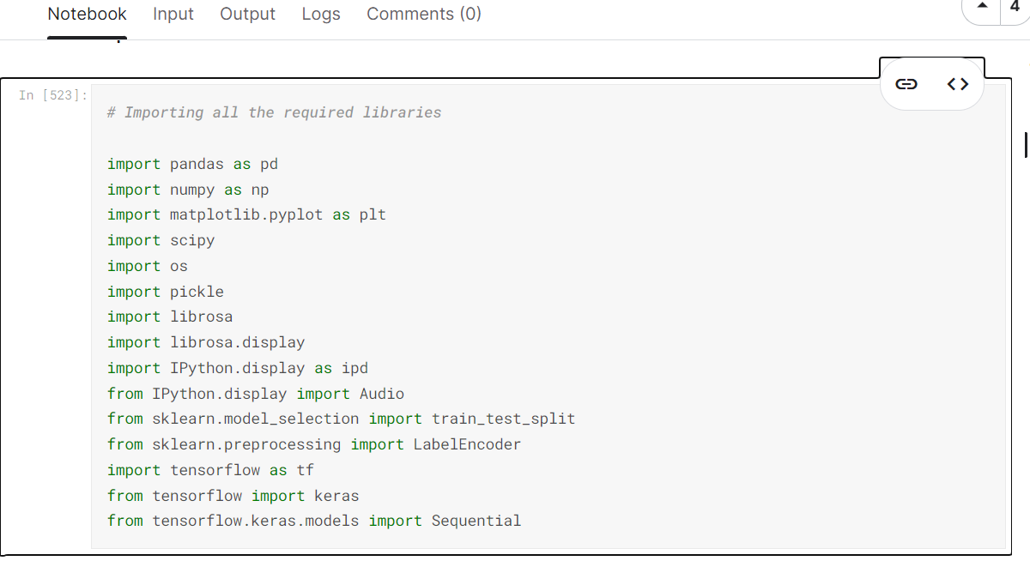
MODULE 1: Importing libraries
Step:1 Import required libraries

Slide 11
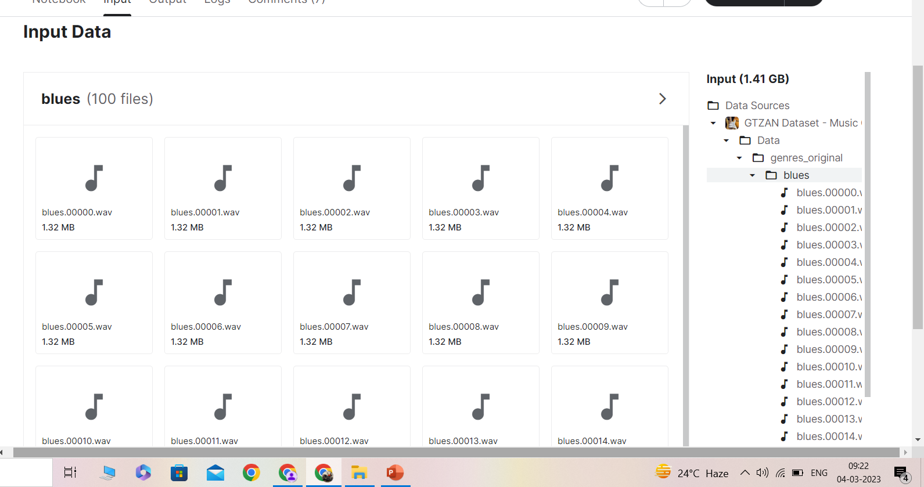
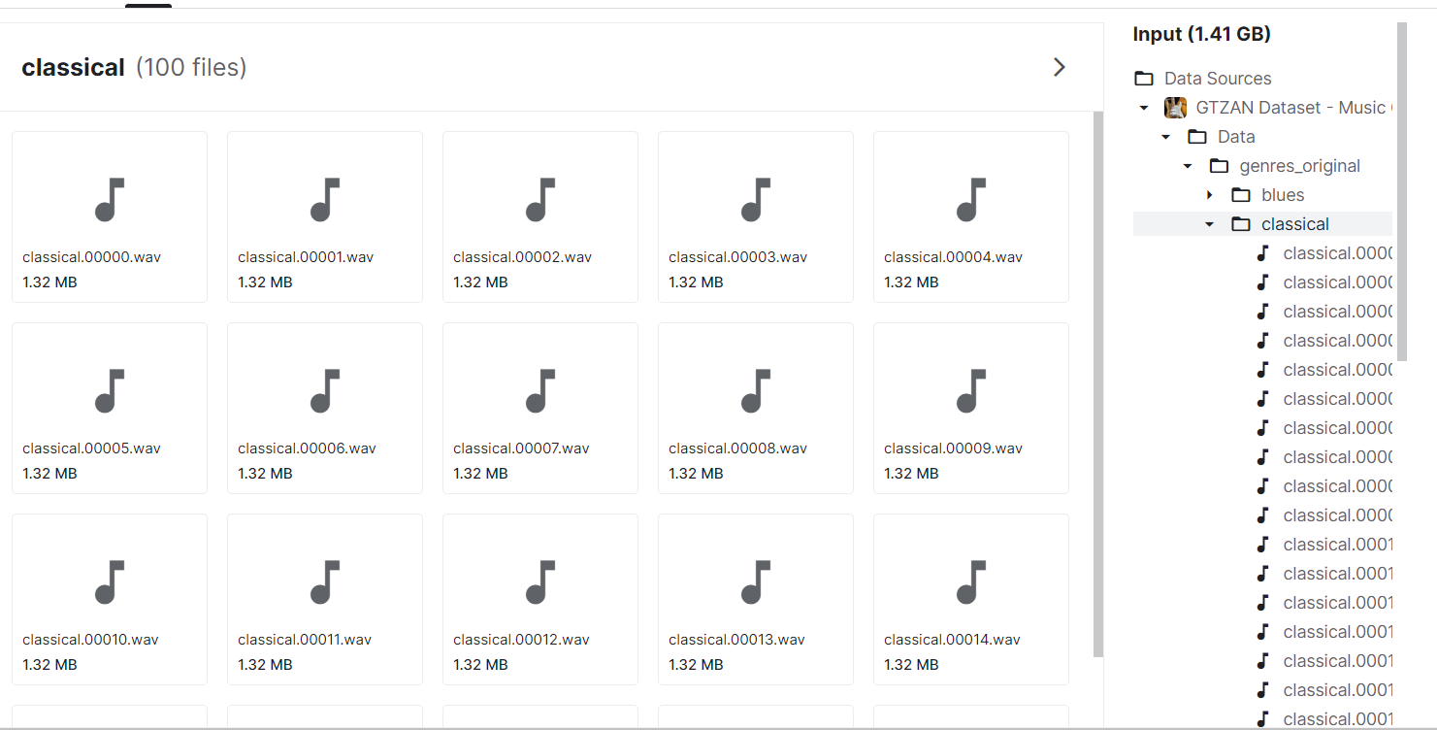
Step 2: processing of data

Slide 12
Module 2- MACHINE LEARNING ALGORITHM(KNN)
• One of them, K-Nearest Neighbour (KNN), is a technique that has been reportedly successful in categorizing music into different genres.
• A supervised machine learning algorithm, the K-Nearest Neighbour technique is used to find solutions for classification and regression problems.
• Relying on labeled input data to process unlabeled data in the future, this ML technique is used in music genre classification.
Step 1: Select the value of K neighbors(say k=5).
Step 2: Find the K (5) nearest data point for our new data point based on Euclidean distance(which we discuss later).
Step 3: Among these K data points count the data points in each category.
Step 4: Assign the new data point to the category that has the most neighbors of the new datapart

Slide 13
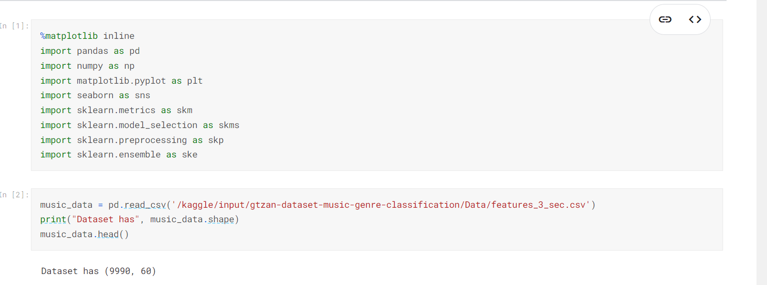
Step 3: Apply machine learning algorithms

Slide 14
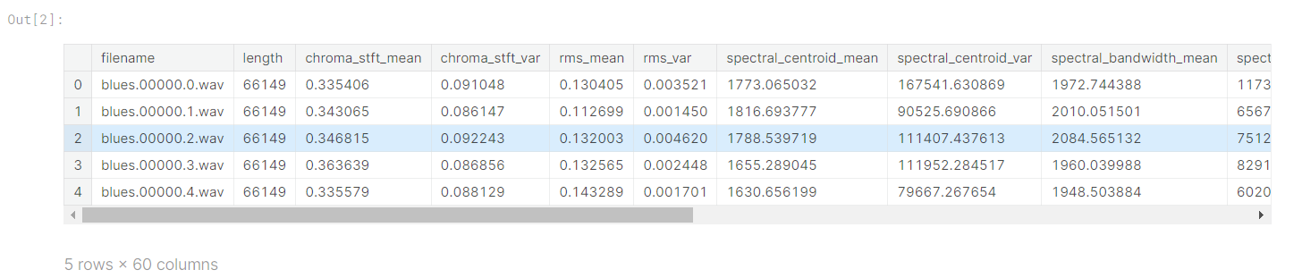
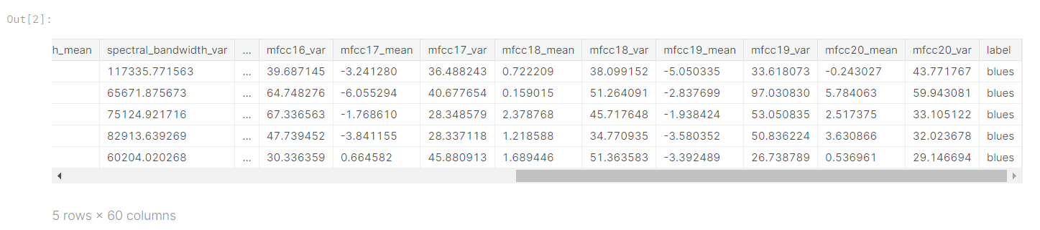
Step 4: The output

Slide 15
IMPLEMENTATION
Architecture Diagram
Data –Flow Diagram
Use Case Diagram
Class Diagram
Activity Diagram
Sequence Diagram
Collaboration Diagram(If applicable)
E-R Diagram

Slide 16
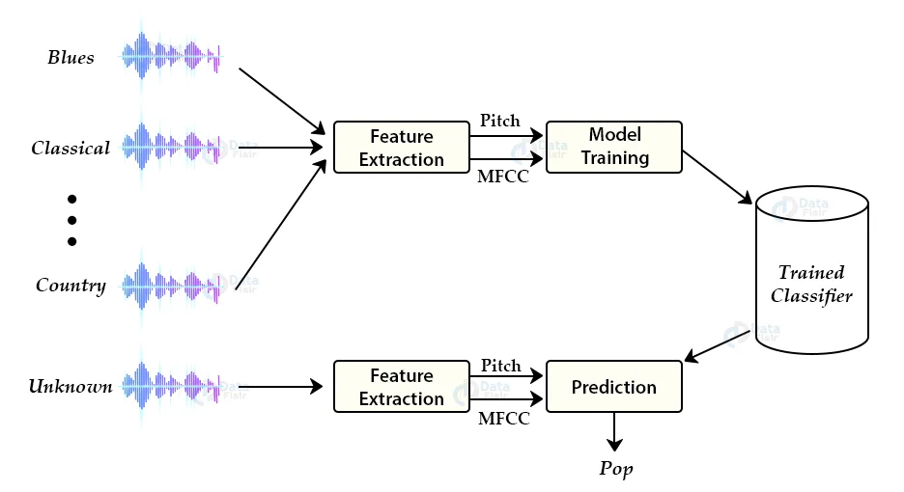
Architecture Diagram

Slide 17
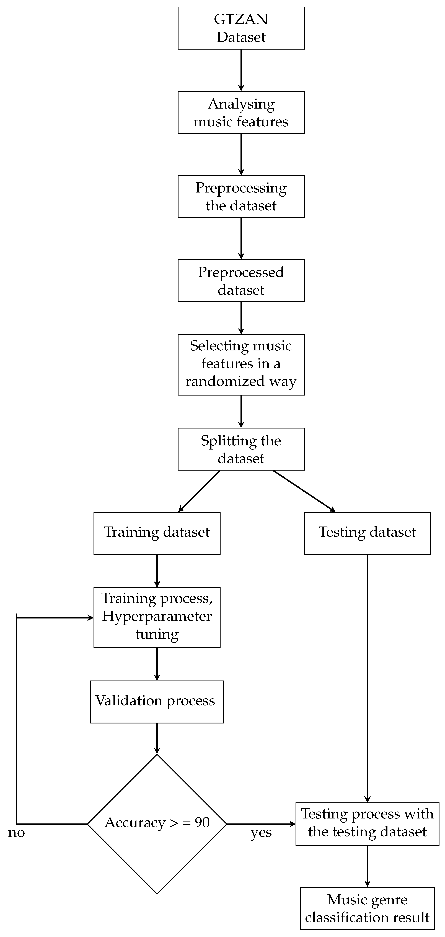
Data –Flow Diagram

Slide 18
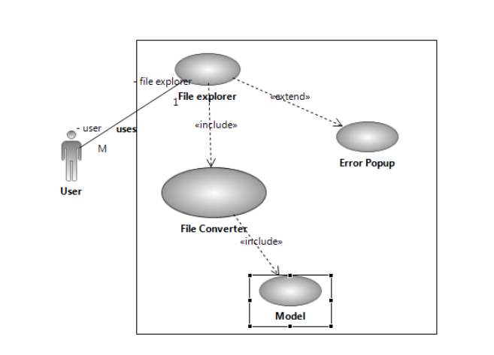
Use Case Diagram

Slide 19
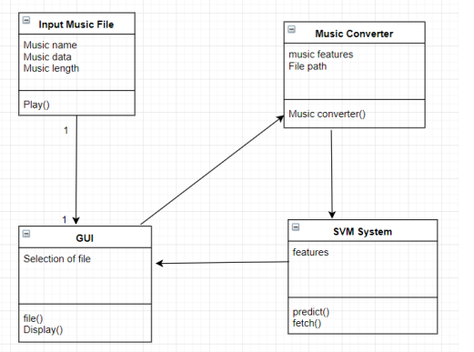
Class Diagram

Slide 20
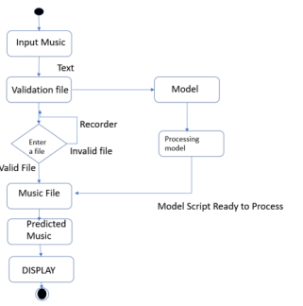
Activity Diagram

Slide 21
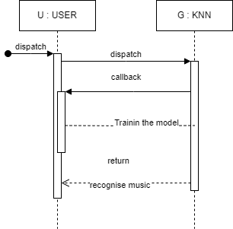
Sequence Diagram

Slide 22
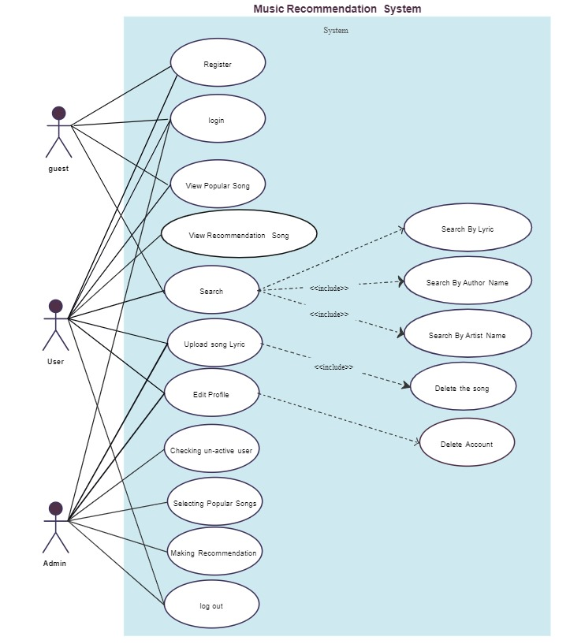
E-R Diagram

Slide 23
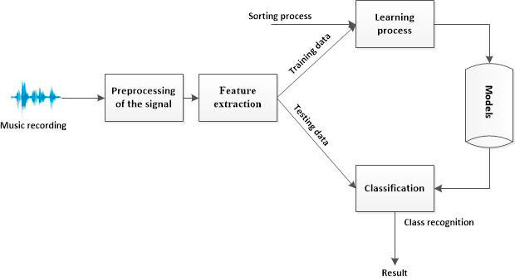
Collaboration Diagram

Slide 24
REFERENCES
A. Karatana and O. Yildiz, “Music genre classification with machine learning techniques,” in Signal Processing and Communications Applications Conference (SIU), 2017 25th, IEEE, 2019, pp. 1–4.
A. Tzanetakis, G. and Cook, P. “Musical genre classification of audio signal”, IEEE Transactions on Speech and Audio Processing, Vol. 10, No. 3, pp. 293-302, July 2020.
Holzapfel, A. and Stylianou Y. “Musical genre classification using nonnegative matrix factorization-based features”, IEEE Transactions on Audio, Speech, and Language Processing, Vol. 16, No. 2, pp. 424-434, 2019.
Sturm, B. L. (2020). The GTZAN dataset: Its contents, its faults,their effects on evaluation, and its future use. arXiv preprintarXiv:1306.1461.
Gemmeke, J. F., Ellis, D. P., Freedman, D., Jansen, A., Lawrence,W., Moore, R. C., ... & Ritter, M. (2017, MarEEE International Conference on Acoustics, Speech and Signal Processing (ICASSP) (pp. 776-780) IEEE. Audio set: Anontology and human-labeled dataset for audio events. In 2020

Slide 25
Ajoodha, R., Klein, R., & Rosman, B. (2019, November). Single- labelled music genre classiﬁ cation using content-based features. In 2015 Pattern Recognition Association of South Africa and Robotics and Mechatronics International Conference (PRASA- RobMech) (pp. 66-71). IEEE.
Xu, C., Maddage, N. C., Shao, X., Cao, F., & Tian, Q. (2003,April). Musical genre classification using support vector machines. In 2003 IEEE International Conference on Acoustics,Speech, and Signal Processing, 2003. Proceedings.(ICASSP’03).(Vol. 5, pp. V-429). IEEE
Balachandra K, Neha Kumari, Tushar Shukla, Kumar Satyam, “Music Genre Classification for Indian Music Genre”, IJRASET – 2021.
Hareesh Bahuleyan, “Music Genre Classification using Machine Learning Techniques”, arXiv:1804.01149v1 [cs.SD] – 2018.
Nirmal M R, “Music Genre Classification using Spectrograms”, International Conference on Power, Instrumentation, Control and Computing (PICC) – 2020.
https://www.kaggle.com/andradaolteanu/gtzandataset-music-genre-classification

Slide 26
THANK YOU

